Slide 1
The PCI bus
Peripheral Component Interconnect
Kamalanath Samarakoon

Slide 2
Main features
Stared in 1990 by Intel
Now standards maintained by PCI-SIG (Special Interest Group)
PCI Bus is slower (33 MHz/66 MHz) than Host Bus (100,133,400, 800 MHz Front Side Bus (FSB))
Coupling of the processor and expansion bus by means of a bridge

Slide 3
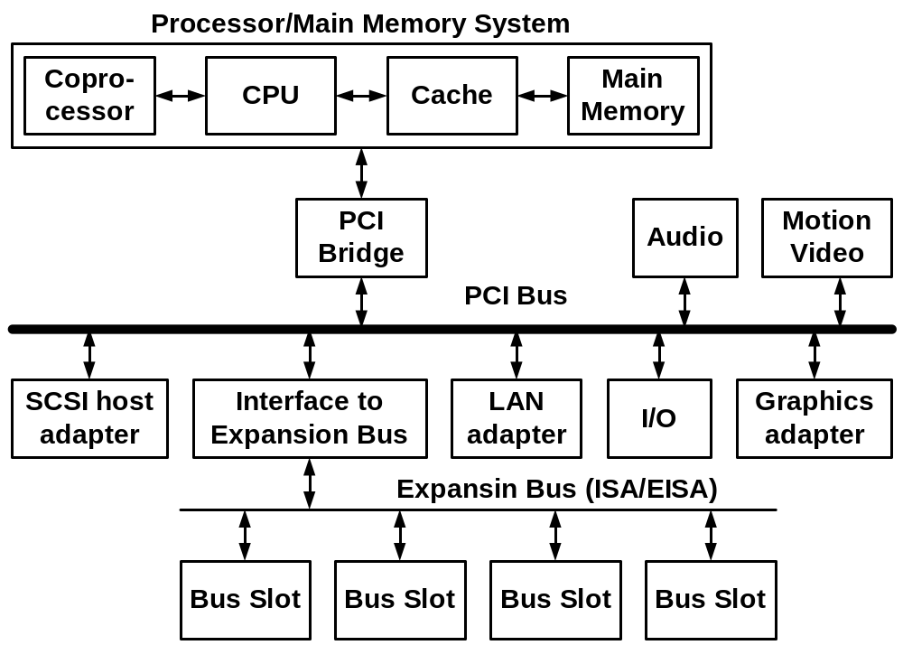
Block diagram of a PCI bus system

Slide 4
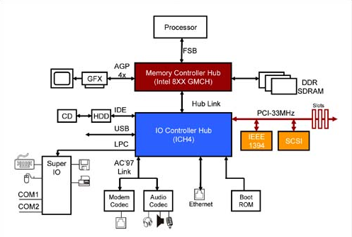
Latest Generation of PCI Chipsets

Slide 5
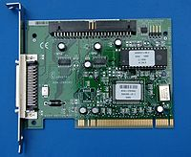
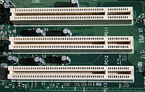
Ver 1.0 PCI 32 bit 5V
  32-bit standard bus width , 33 MHz Clock, max transfer rate of 133 Mbytes/s
  expansion to 64 bits with a maximum transfer rate of 266 Mbytes/s,
  5 V

Slide 6
Main features
2.0
  3.3 V Flipped notch
  Universal card 3.3 and 5 V have two notches
2.1
  Optional 66 MHz PCI-32/66 266 MB/s, PCI-64/66 532 MB/s
2.2
  Mini PCI for Laptops
2.3
  Stopped 5 V only adapter. Available with 3,3 V
3.0
  No 5 V support

Slide 7
Main features
PCI-X 1.0 (PCI Extended)
  PCI X 66 PCI X 133 = 66MHx and 133 MHz
  With 64 bit PCI-64/66 532 Mbytes/s,PCI-X 64/133 1064 Mbytes/s
  3.3 and 5 V or 3.3 V only (No 5 V)
PCI X 2.0
  Fully backward compatible
  2 additional speeds
  PCI-64/266 2.13 GB/s,PCI-X 64/533 4.26GB/s
PCI X 3.0
  PCI-X 1066 8.53GB/s
  PCI-X 2133 17.07GB/s

Slide 8
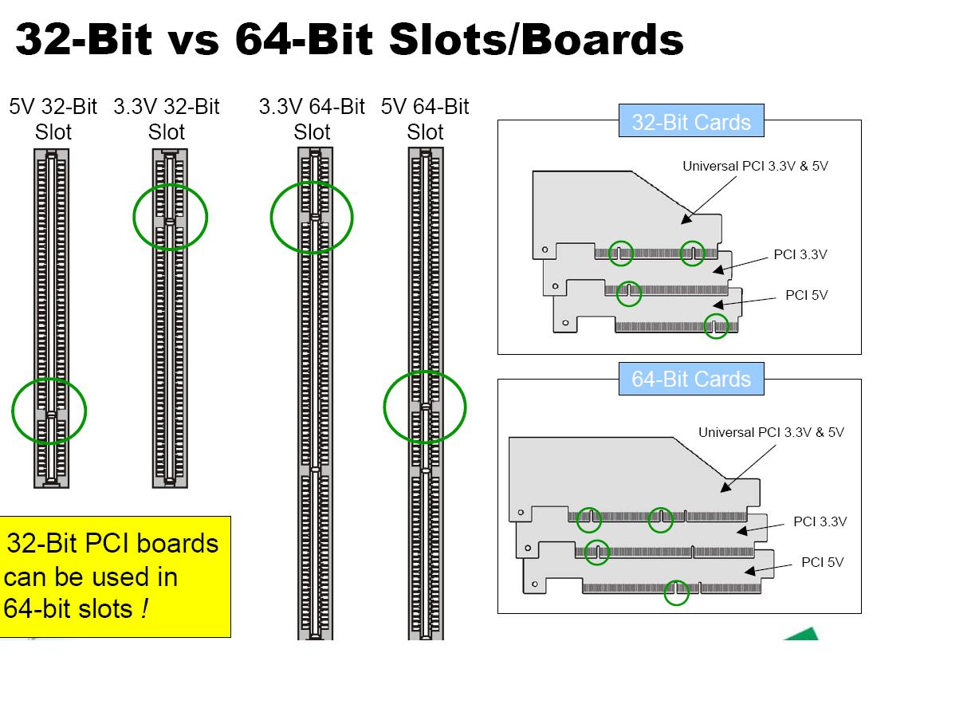

Slide 9
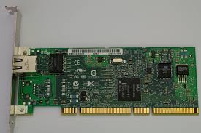
PCI 64bit 3.3 V and 5V

Slide 10
PCIe- PCI Express
Incompatible with PCI and PCIx
A serial bus
Studied separately

Slide 11
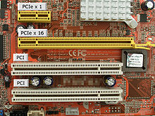
PCI 5V, PCI express x1 and x16

Slide 12
Signals
CLK
  Clock provide timing reference for all transfers (Synchronous bus)
  All signals (Except Reset/Int) sampled on the rising edge of the cock
  Min frequency=0 Hz for clock to be suspended for power saving purposes
RST# (#=active low)
  Hardware reset of a PCI device
  PCI devices configuration registers, state machines, O/P siignals will be placed in initial state
  Remain active for 100us after CLK become stable to ensure all PCI devices are reset (Power on reset)

Slide 13
Address and Data lines
AD[31:0] – Address and Data are multiplexed and has two phases
  Address phase – Transfer 32 bit address
  Data phase – Transfer 32 bit of data
C/BE[3:0]#- Bus Command and Byte Enable are multiplexed
  Address phase: Carries bus command that define the type of transfer to be performed
  Data phase: Carries byte enable (active low) information
  | MSB | | | LSB |
  | C/BE[3]# | C/BE[2]# | C/BE[1]# | C/BE[0]# |

Slide 14
Interface Control Lines
FRAME#
  Driven by a initiater
  To signal start of new bus transaction
  Address phase occurs during the first clock after high to low transition
  Then data phase starts
  Hold low to end of transaction or one before last data phase

Slide 15
IRDY# Initiator Ready
Driven low by the initiator
To indicate that initiator is ready to complete current data phase
Write data phase
  Indicate Initiator has placed valid data on AD[31:0]
Read data phase
  Indicate Initiator ready to accept data
Once asserted Initiator holds IRDY# low until TRDY# is low to complete transfer or target se STOP# to terminate
This permit the initiator to insert wait state to sloe the data transfer

Slide 16
TRDY# Targert ready
Driven low by the target
To indicate that target is ready to complete current data phase
Write data phase
  Indicate Target ready to accept data
Read data phase
  Indicate target has placed valid data on AD[31:0]
Once asserted Target holds TRDY# low until IRDY# is low to complete
This permits target to initiate wait state as needed to slow the data transfer

Slide 17
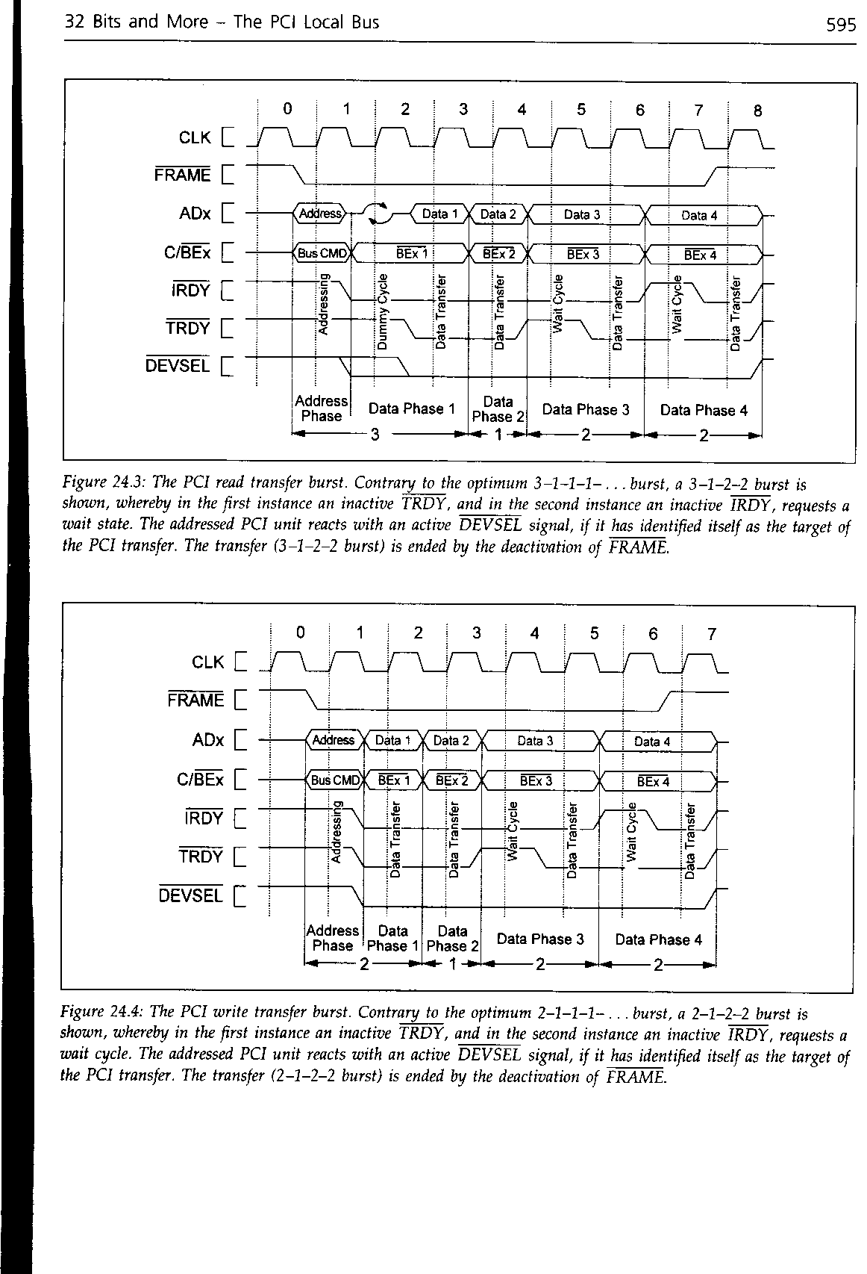
The PCI read transfer burst

Slide 18
The PCI write transfer burst.

Slide 19
Auto configuration
PCI device supports rigorous auto configuration mechanism
Each PCI device and each function of a device (if multifunction device) has 256 byte configuration are of 64 nos 32 bit registers (64x4 bytes=256 Bytes)

Slide 20
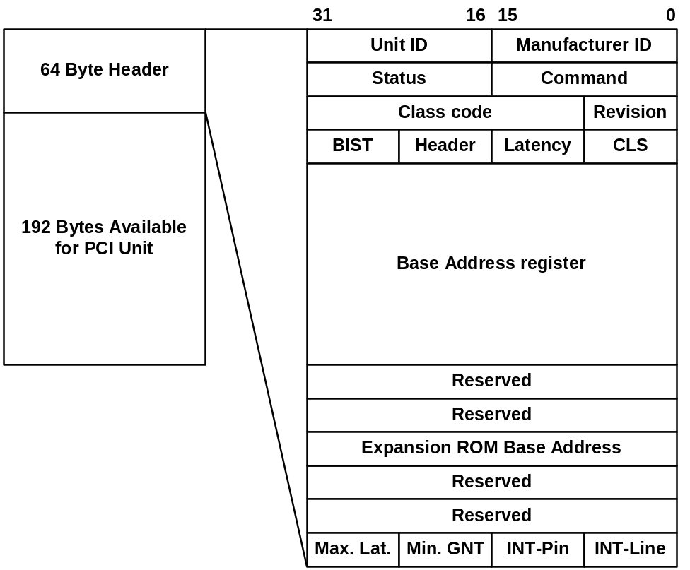
Configuration Address Space
First 64 are fixed header area. It include device identification data for driver loading such as
  Manufacturer ID
    allocated by PCI SIG
  Unit ID, revision
    identifies unit
  Class code
    type of PCI unit

Slide 21
I/O address of PCI bus
It uses I/O address space of PC to read/write PCI configuration registers
PC I/O address previously reserved for mother board are given to PCI configuration
  0CF8h - CONFIG_ADDRESS 32 bit
  0CFCh - CONFIG_DATA 32 bit
These addresses do not conflict with ISA/EISA/MCA I/O address
Write PCI address to CONFIG_ADDRESS Register
Read from write to CONFIG_DATA Register

Slide 22
I/O address of PCI bus
Address
0CF8
PCI device addresed by CONFIG_ADDRESS
PCI Contoller
0CFC
Data
Write PCI address to CONFIG_ADDRESS Register
Read from write to CONFIG_DATA Register
Read/Write

Slide 23
CONFIG_ADDRESS
31
0
EDC
Reserved
Bus
Unit
Function
Register
Type
Register bit 2-7 64 possible registers in configuration area
Function bit 8-10: 8 possible functions in multifunction device
Units bit 11-15: One of 32 possible PCI Agents
BUS bit 16-23: If several busses arrange in hierarchy (closest to CPU=0)
EDC=0 Config data not activates
Type 2 bits: Transfer type 00 Decode Unit (Read/Write content of the reg by decoding, 01 Value copy to ADX: Read /write as a single value

Slide 24
Bus Arbitration
  Parallel arbitration
  Hidden arbitration
  Arbitration algorithm is not defined
DMA
  Burst transfers
Interrupts
  INTA# activated
  Data: interrupt vector

Slide 25
Bus Cycles
INTA sequence (0000)
special cycle (0001)
I/O read access (0010)
I/O write access (0011)
memory read access (0110)
memory write access (0111)
configuration read access (1010)
configuration write access (1011)
memory multiple read access (1100)
dual addressing cycle (1101)
line memory read access (1110)
memory write access with invalidation (1111)

Slide 26
Status and Command Registers
Status:
  PER: Parity error
  SER: System error
  MAB: Master abort
  TAB: Target abort received
  STA: Target abort signaled
  DEVTIM: DEVSEL timing
    00=fast 01=medium 10=slow 11=reserved
  DP: Data parity error
  FBB: Fast back-to-back cycles supported/unsupported
Command:
  BEE: Fast back-to-back cycles (Back-to-Back Enable)
  SEE: SERR Enable
  WC: Wait cycle control
  PER: Parity error (Parity Error Response)
  VPS: VGA palette snoop
  MWI: Memory write access with invalidation
  SC: Special cycle
  BM: Busmaster
  MAR: Activate/deactivate Memory address area
  IOR: Activate/deactivate I/O address area

Slide 27
Accessing Configuration Address Space
Configuration Mechanism #1
  CONFIG-ADDRESS (0cf8h) and CONFIG-DATA (0cfch) registers are defined in the I/O area
Configuration Mechanism #2 (for PC systems)
  4k I/O address range between c000h and cfffh

Slide 28
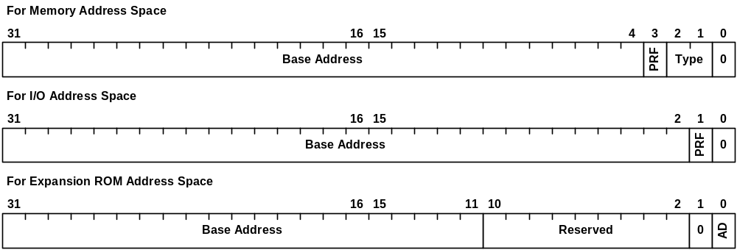
Base Address Registers
PRF: Prefetching not possible/prefetching possible
Type: Positioning type
  00=any 32-bit address, 01=less than 1M, 10=any 64-bit address, 11=reserved
AD: Address decoding and expansion ROM deactivated/activated

